Slide 1
Jude
Mercy, Peace, and Love

Slide 2
Jude: Mercy, Peace, and Love
Godly
Ungodly

Slide 3
Jude: Mercy, Peace, and Love
Godly
Opposites
Ungodly

Slide 4
Jude: Mercy, Peace, and Love
Condemned; without truth;
Without hope;
and without
the Spirit
Godly
Opposites
Called
Sanctified
Kept
Ungodly

Slide 5
Jude: Mercy, Peace, and Love
Recognising the Ungodly

Slide 6

Jude: Mercy, Peace, and Love
Recognising the Ungodly
within the church
misrepresenting the Gospel
denying Christ

Slide 7
Jude: Mercy, Peace, and Love
Recognising the Ungodly
They indulge in sexual immorality and pursue unnatural desires
They rely on their dreams
They defile the flesh
They reject authority
They think nothing of speaking evil of dignities.
They speak evil against or blaspheme all that they do not understand.
they corrupt themselves in those things that are plain and obvious to natural reason and conscience

Slide 8
Jude: Mercy, Peace, and Love
Recognising the Ungodly
The accusation:
their deceitfulness lies
not in their lack of understanding,
but in their evil desires and by their own will

Slide 9
Jude: Mercy, Peace, and Love
Recognising the Ungodly
They indulge in sexual immorality and pursue unnatural desires
They rely on their dreams
They defile the flesh
They reject authority
They think nothing of speaking evil of dignities.
They speak evil against or blaspheme all that they do not understand.
they corrupt themselves in those things that are plain and obvious to natural reason and conscience
They abandon themselves for the sake of gain.

Slide 10
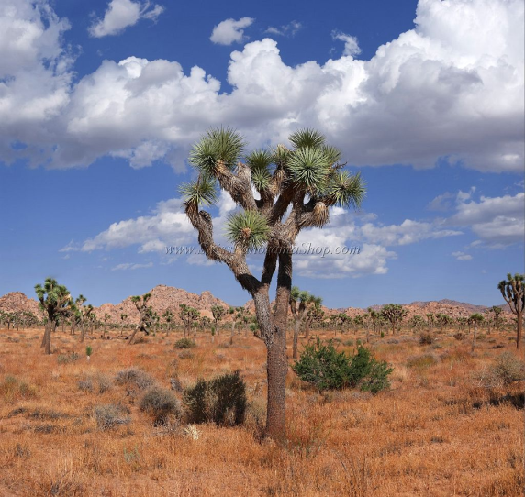
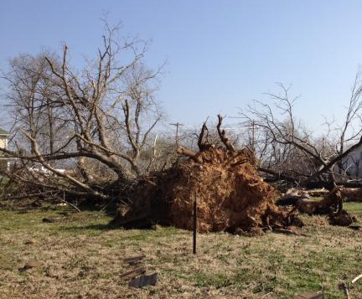
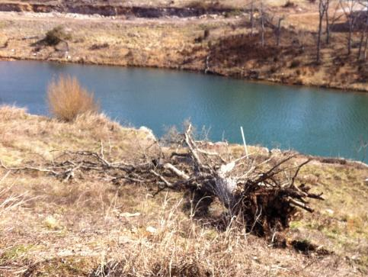
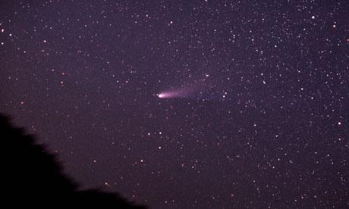
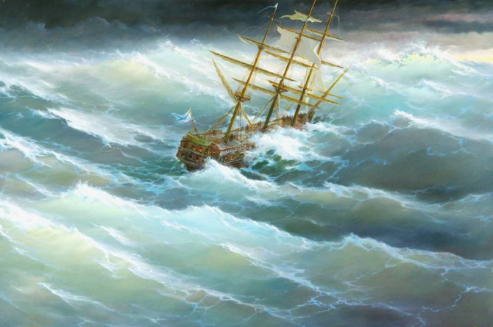
Jude: Mercy, Peace, and Love
Recognising the Ungodly
They indulge in sexual immorality and pursue unnatural desires
They rely on their dreams
They defile the flesh
They reject authority
They think nothing of speaking evil of dignities.
They speak evil against or blaspheme all that they do not understand.
they corrupt themselves in those things that are plain and obvious to natural reason and conscience
They abandon themselves for the sake of gain.

Slide 11



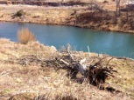

Jude: Mercy, Peace, and Love
Recognising the Ungodly
They indulge in sexual immorality and pursue unnatural desires
They rely on their dreams
They defile the flesh
They reject authority
They think nothing of speaking evil of dignities.
They speak evil against or blaspheme all that they do not understand.
they corrupt themselves in those things that are plain and obvious to natural reason and conscience
They abandon themselves for the sake of gain.
They murmur, complain
They boast, doing things for their own advantage
They cause division
They are worldly

Slide 12
Jude: Mercy, Peace, and Love
Recognising the Ungodly
Without
the
Spirit
They indulge in sexual immorality and pursue unnatural desires
They rely on their dreams
They defile the flesh
They reject authority
They think nothing of speaking evil of dignities.
They speak evil against or blaspheme all that they do not understand.
they corrupt themselves in those things that are plain and obvious to natural reason and conscience
They abandon themselves for the sake of gain.
They murmur, complain
They boast, doing things for their own advantage
They cause division
They are worldly

Slide 13
Jude: Mercy, Peace, and Love
Recognising the Ungodly
But I’m not like that!!!!!

Slide 14
Jude: Mercy, Peace, and Love
Recognising the Ungodly
But I’m not like that!!!!!
Be Discerning

Slide 15

Jude: Mercy, Peace, and Love
Recognising the Ungodly
2 Corinthians 11:
And what I am doing I will continue to do, in order to undermine the claim of those who would like to claim that in their boasted mission they work on the same terms as we do. For such men are false apostles, deceitful workmen, disguising themselves as apostles of Christ. And no wonder, for even Satan disguises himself as an angel of light. So it is no surprise if his servants, also, disguise themselves as servants of righteousness.
Their end will correspond to their deeds.
Without
the
Spirit

Slide 16
Jude: Mercy, Peace, and Love
Recognising the Godly

Slide 17
Jude: Mercy, Peace, and Love
Recognising the Godly
No confusion about what they believe

Slide 18
Jude: Mercy, Peace, and Love
Recognising the Godly
No confusion about what they believe
The godly are servants of Jesus Christ

Slide 19
Jude: Mercy, Peace, and Love
Recognising the Godly
No confusion about what they believe
The godly are servants of Jesus Christ
The Godly are servants because they were called

Slide 20
Jude: Mercy, Peace, and Love
Recognising the Godly
No confusion about what they believe
The godly are servants of Jesus Christ
The godly are servants because they were called
The godly are sanctified

Slide 21
Jude: Mercy, Peace, and Love
Recognising the Godly
No confusion about what they believe
The godly are servants of Jesus Christ
The godly are servants because they were called
The godly are sanctified
The godly are kept

Slide 22
Jude: Mercy, Peace, and Love
Recognising the Godly
No confusion about what they believe
The godly are servants of Jesus Christ
The godly are servants because they were called
The godly are sanctified
The godly are kept
The godly have hope

Slide 23
Jude: Mercy, Peace, and Love
Recognising the Godly
No confusion about what they believe
The godly are servants of Jesus Christ
The godly are servants because they were called
The godly are sanctified
The godly are kept
The godly have hope
The godly have a burden for the ungodly

Slide 24
Jude: Mercy, Peace, and Love
Rescuing the Ungodly

Slide 25
Jude: Mercy, Peace, and Love
Rescuing the Ungodly
Be prepared!
  The godly must build themselves up in their most holy faith.
  The godly must build themselves up in praying in the Holy Spirit
  The godly must keep themselves in God’s love

Slide 26
Jude: Mercy, Peace, and Love
Rescuing the Ungodly
Be prepared!
  The godly must build themselves up in their most holy faith.
  The godly must build themselves up in praying in the Holy Spirit
  The godly must keep themselves in God’s love
Know their end!
…but for mercy, peace, love

Slide 27
Jude: Mercy, Peace, and Love
Rescuing the Ungodly
Be prepared!
  The godly must build themselves up in their most holy faith.
  The godly must build themselves up in praying in the Holy Spirit
  The godly must keep themselves in God’s love
Know their end!
…but for mercy, peace, love
  Take Action!

